Slide 1

Resume Builder
Soham Shigvan - 22107001
Renuka Udugade -22107048
Konika Yadav - 22107006
Project Guide
Prof. Sheetal Jadhav

Slide 2
Contents
Introduction
Objectives
Scope
Features / Functionality
Project Outcomes
Technology Stack
Block Diagram

Slide 3
1. Introduction
Resume builder refers to the initial section of the tool or software where you input your personal and professional information to create a well-structured resume.
Problem Identified :
Lack of Experience : Some individuals, especially those just starting careers, struggle with crafting a compelling resume due to limited work experience.

Slide 4
1. Introduction
Solution Proposed :
The solution proposed by a resume builder system is a comprehensive and user-friendly platform that assists individuals in creating polished and professional resumes.
Templates : The system provides a variety of professionally designed resume templates. Users can choose a template that suits their industry, career level, and personal style.
User-Friendly Interface: The system offers a user-friendly and intuitive interface that guides users through the resume creation process. It typically provides easy-to-follow steps and templates for creating a professional resume.

Slide 5
2. Objectives
To empower users to create compelling, tailored resumes that increase their chances of landing job interviews and advancing in their careers.
To help users save time by automating the process of resume creation, eliminating the need to start from scratch.
To assist users in creating resumes that are polished, well-formatted, and aligned with industry standards.

Slide 6
3. Scope
A user-friendly resume creation and editing interface.
Database integration to store resume data.
An intuitive user interface for a seamless user experience.
Simplifies the task of creating a resume for individuals.
To utilize resources in an efficient manner by increasing their productivity through automation.

Slide 7
4. Feature
Resume Creation and Editing.
Real-time Preview.
Data Storage and Retrieval.
Export to PDF, Fax, OneNote (desktop), Microsoft document, Print it directly.
User-Friendly Interface.

Slide 8
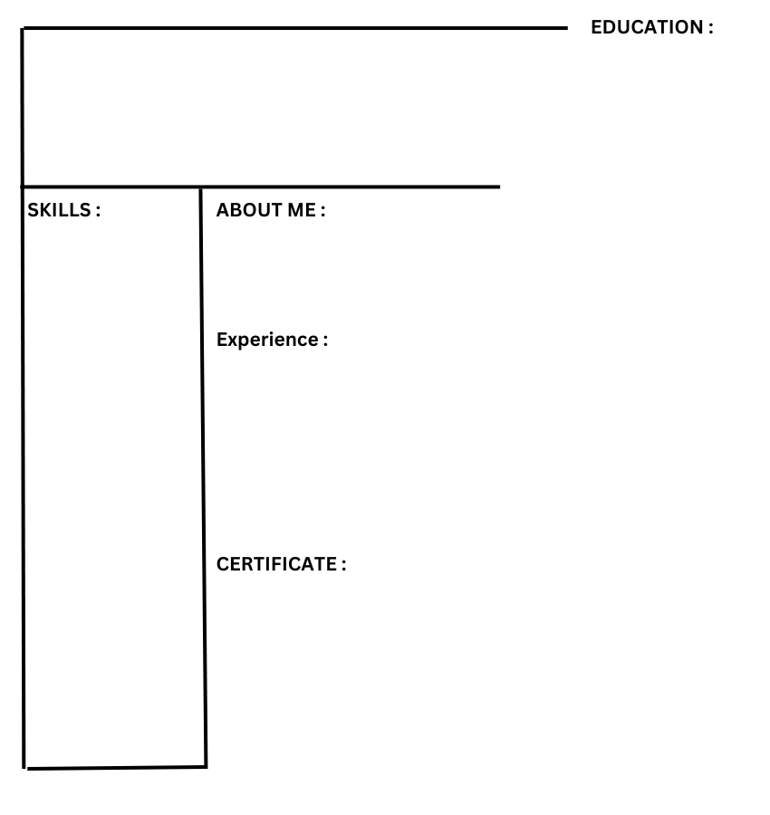
EXPERIENCE TEMPLATE NO 1

Slide 9
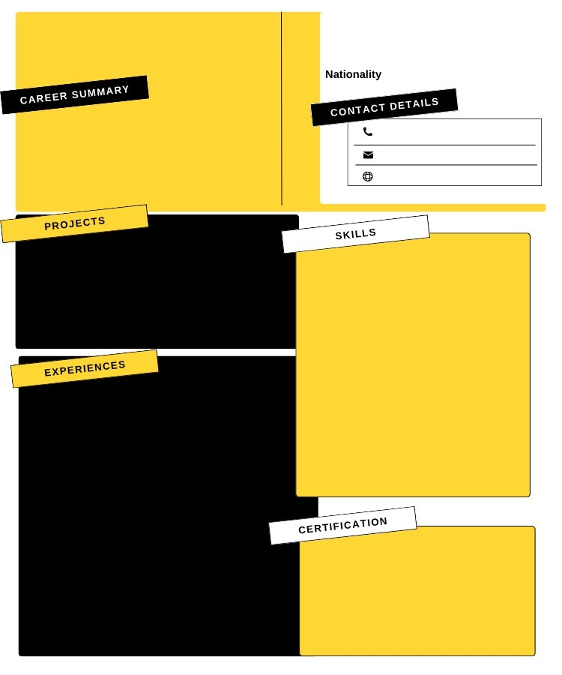
EXPERIENCE TEMPLATE
NO 2

Slide 10
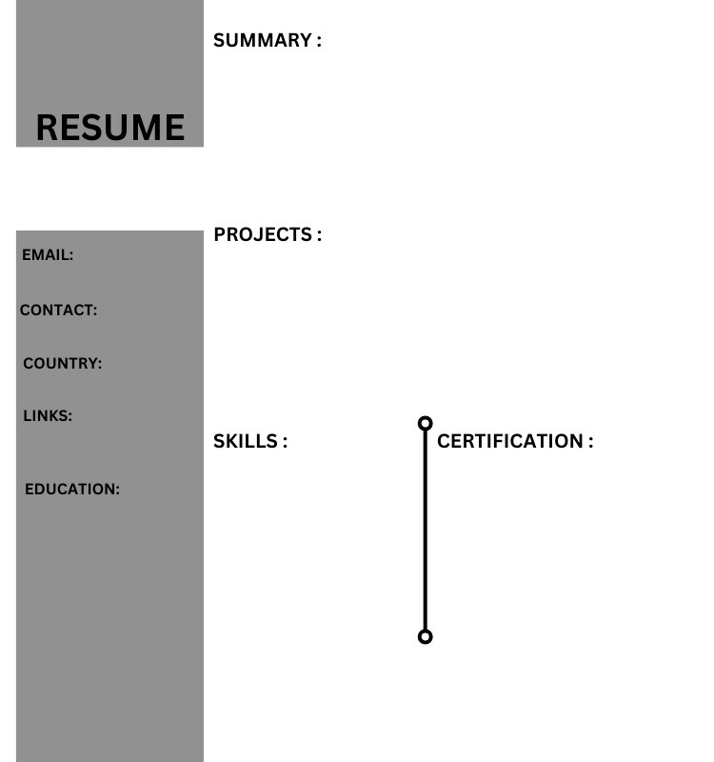
INTERNSHIP
TEMPLATE
NO 1

Slide 11
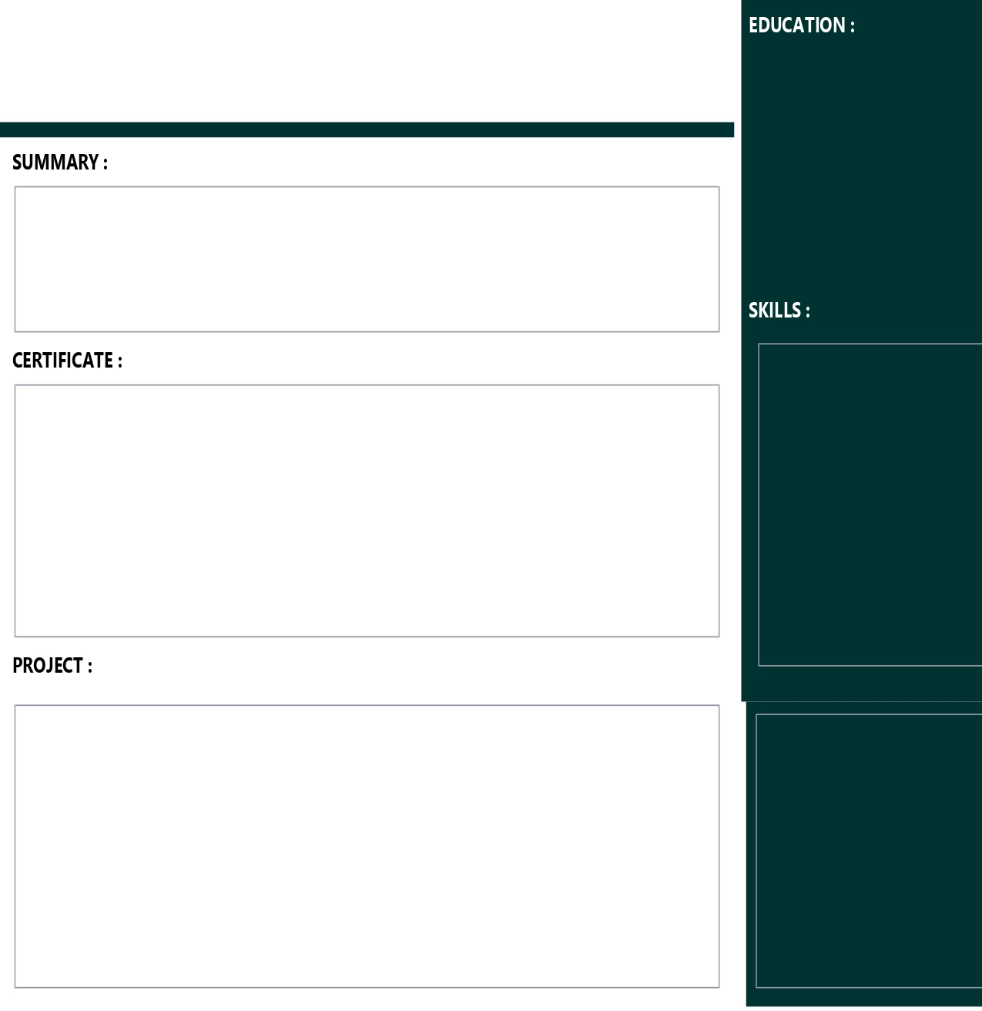
INTERNSHIP
TEMPLATE
NO 2

Slide 12
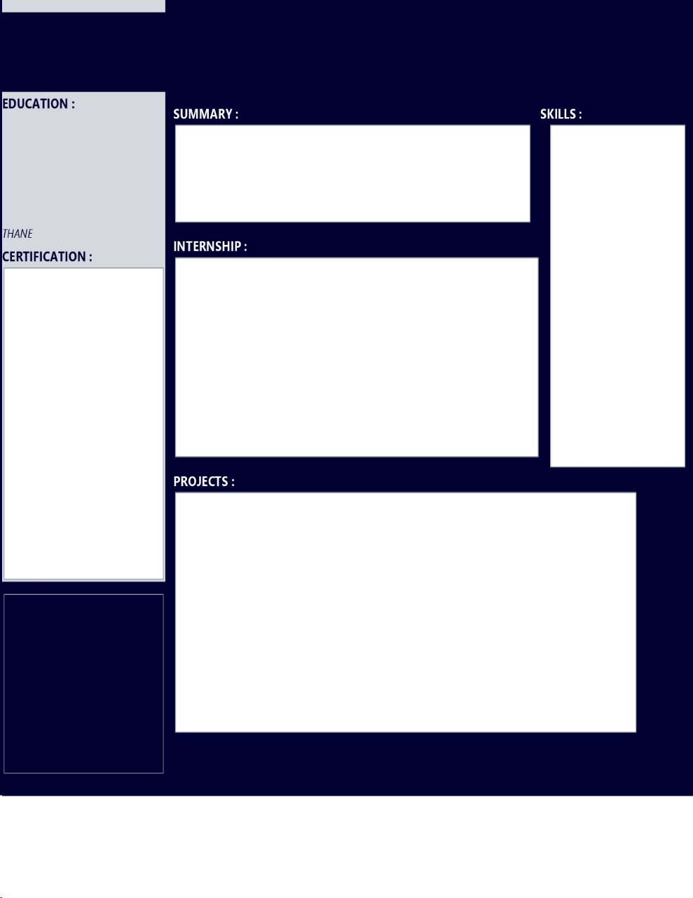
FRESHER
TEMPLATE
NO 1

Slide 13
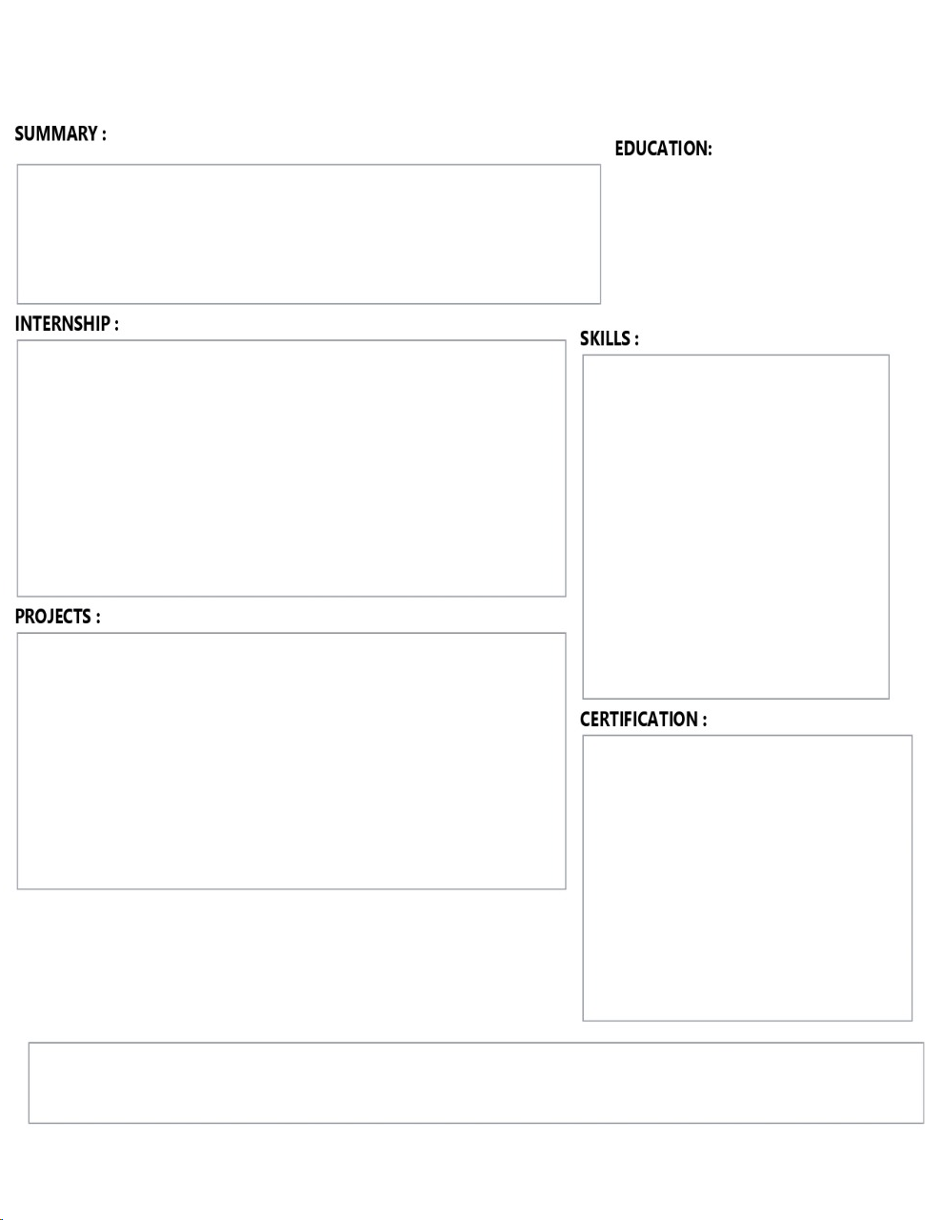
FRESHER
TEMPLATE
NO 2

Slide 14
DIFFERENCE IN TEMPLATES
INTERNSHIP | FRESHER | EXPERIENCE
PERSONAL DETAILS* | PERSONAL DETAILS* | PERSONAL DETAILS*
EDUCATION DETAILS* | EDUCATION DETAILS* | EDUCATION DETAILS*
SKILLS,PROJECTS* | SKILLS,PROJECTS* | SKILLS,PROJECTS*
ADD MORE DETAILS | ADD MORE DETAILS | ADD MORE DETAILS
 | INTERNSHIP | EXPERIENCE

Slide 15
5. Outcome of Project
An user-friendly Resume Builder application.
Empowering job seekers with a tool to create compelling resumes.
The ultimate outcome of resume depends on the quality of the information user provide, user experiences, and how well user tailor his/her resume to the specific job applying for.

Slide 16
6. Technology Stack
Front End
Java Jdk 18.02 - For the core application logic and user interface.
Apache Netbens IDE - Providing a robust development environment
Back End
MySQL 8.0 - Storing and managing user resume data securely.

Slide 17
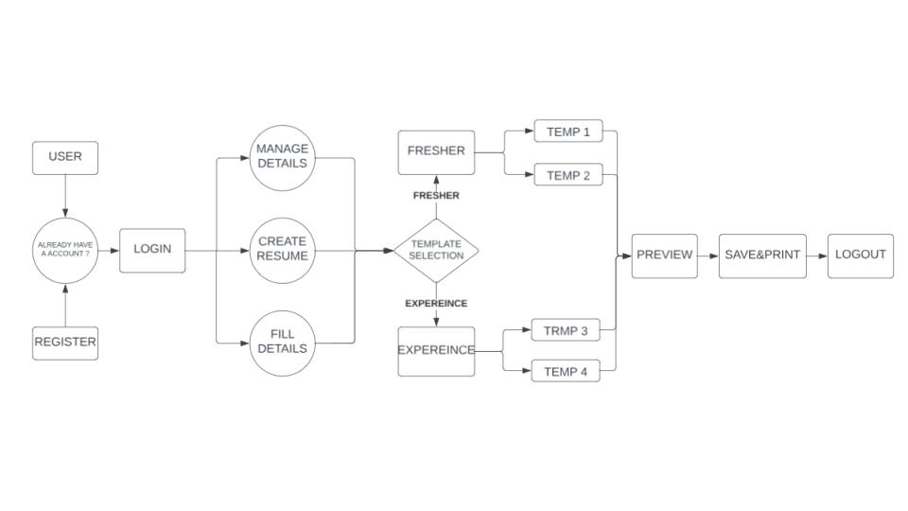
7. Block Diagram

Slide 18
Thank You...!!

